Slide 1
EMAIL WRITING
HANOI – AUG, 2016
Trình bày: Nhuytt

Slide 2
Agenda
Email Format vs Languages
Email Template in Qsoft
Some Notes
Q&A

Slide 3
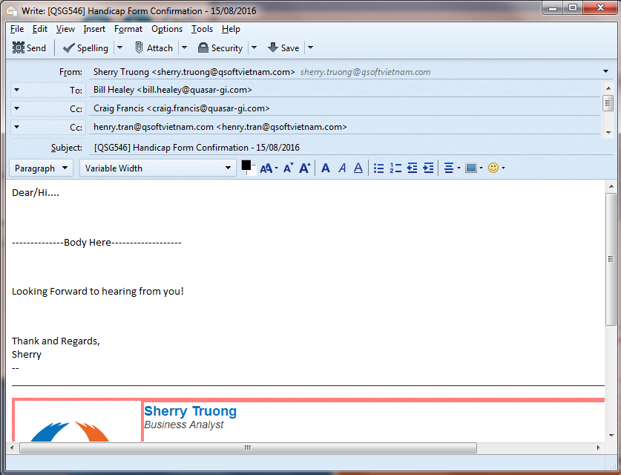
I. Email Format

Slide 4
I. Email Format 1. Recipient
To
People – in – Charge
People – in – Charge
cc
Your direct manager
Sponsor
Any one who need to be informed
Sales

Slide 5
I. Email Format 2. Subject Line
Project Code
Topic
Date (if any)
[QSG546] Booking Form Confirmation – 15/08/2-16

Slide 6
I. Email Format 3. Salutation
Salutation
English
Dear
Hi
Vietnamese
Chào/Gửi Anh/Chị A/B
Dear Anh/Chị A/B

Slide 7
I. Email Format 4. Body
Content
Brief
Formal enough
To the point
Informative

Slide 8
I. Email Format 5. Closing
Closing
English
Vietnamese
Thank you and Best Regards
Regards
Kind Regards
Sincerely
Yours Sincerely, etc
Trân Trọng
Cảm ơn anh/chị
Regards,

Slide 9
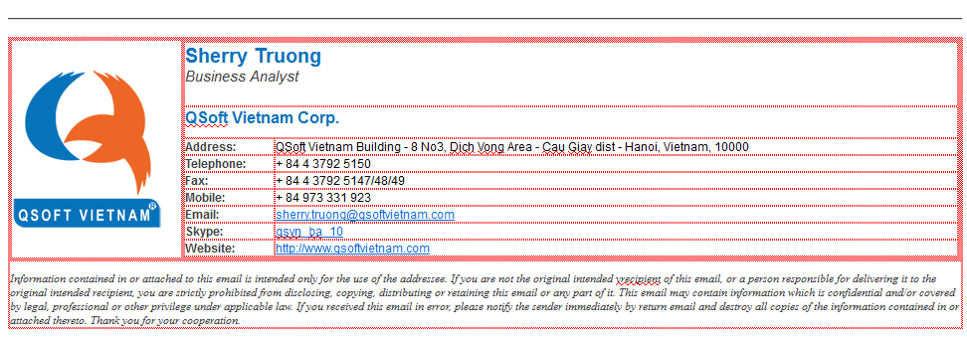
I. Email Format 6. Signature

Slide 10
EMAIL TEMPLATE IN QSOFT
PART 1 – KICK-OFF – SPIRNT 0

Slide 11
1. Introduction Email
Who?
Sales
When?
After Kick-off meeting
What
Introduce stakeholders
Introduce rights/responsibilities of each party

Slide 12
1. Introduction Email
What PO does?
Reply to introduce yourself again
Express your goodwill and best wishes to two parties cooperation
Discuss your expectation on Customer if any

Slide 13
Common Mistakes
Email subject – wrong format
Wrong project code
Recipient – wrong recipient – wrong name
Improper language: informal
Spelling mistakes
Not complete email format

Slide 14
2. Suggested Work Process
Who?
PO
When?
At the beginning of project
What
Suggested work process

Slide 15
2. Suggested Work Process
1. Communication Channels
2. Timeframe for meetings
3. Reports
4. Responses
5. Confirmation process and notes

Slide 16
Common Mistakes
Apply content for all types of project
Improper language
Cannot get customer confirmation and consensus on the suggested process

Slide 17
3. Release Plan
Who
PO
What
Release Plan and tentative schedule – Template provided
When
Sprint 0

Slide 18
QSOFT EMAIL TEMPLATE
PART 2 – DAILY PROGRESS

Slide 19
Part 2 – Daily Process
From
PO
cc
Project Manager
To
Person in charge
Any one who needs informed
Sponsor

Slide 20
1. Confirmation email
Discuss with customer via different communication channels
Summarize elicitation results and visualize with description
Send the summarized email to customer
Get confirmation or feedback

Slide 21
Common Mistakes
Discuss more than one issue in one email thread
Improper email subject
Not clear arguments
Spacing and bullet mistakes
Improper language: informal
No call for actions
No notes for any late reply

Slide 22
2. Daily Reports
What have done
What not done – reasons if any
Plan for next days
Get confirmation or feedback

Slide 23
3. Requirement Confirmation Notes
Emphasize the importance/benefits of timely confirmation
Emphasize the importance/benefits of precise and careful confirmation
Emphasize the consequences of not timely and not careful, and not precise confirmation
Sample Here

Slide 24
QSOFT EMAIL TEMPLATE
PART 3 – UAT

Slide 25
1. Release for UAT
From
PO
To
Person in Charge
CC
Sales
Sponsor
Your Direct Manager
Any one needed to be informed
By the end of release deadline

Slide 26
1. Release for UAT
What?
Email Introduction
UAT Notes
UAT Duration
UAT Deadline
Deliverables
Some instruction/notes
Manual

Slide 27
2. UAT Reminder
When
No feedback in several days
What
Repeat the Deadline
No feedback when deadline is coming
Ask to support if any
Ask for Plan for UAT list

Slide 28
3. Minor Release
From
PO
To
Person in Charge
CC
Sales
Sponsor
Your Direct Manager
Any one needed to be informed
By the end of Sprint

Slide 29
3. Minor Release
Email Content:
Test info
Test site URL Link
Account
Password
List of Done Tasks
Short, Concise
List of Undone tasks (compared to Release Plan)
Short, concise
Next sprint plan

Slide 30
4. End of UAT Confirmation
From
BA
To
Person in Charge
CC
Sales
Sponsor
Your Direct Manager
Any one needed to be informed
By the end of UAT period

Slide 31
4. End of UAT Confirmation
Email Content:
Ask customer to confirm UAT
Confirm payment & deployment schedule
Ask customer to work with sales on final payment
Ask for deployment info & schedule

Slide 32
Common Mistakes
Not clear about scope of work
No call for actions
Not clear arguments

Slide 33
5. Hand- Over Email
From
BA
To
Person in Charge
CC
Sales
Sponsor
Your Direct Manager
Any one needed to be informed
By the end of UAT period

Slide 34
5. Hand- Over Email
Email Content:
Notify of complete deployment
Send manual guidelines & notices about hosting, etc
Thanks for using Qsoft service

Slide 35
III. Some Recommendation
Check Recipients twice
Check email subject twice
Check email content twice
Proper Naming documents
Arrange folfer and Sub-folfer for emails
Particular topic for each email
Avoid off-topic for each email

Slide 36
III. Some recommendation
Mention CR in early emails and confirmation notes
Use too formal or informal Languages
Use negative Languages

Slide 37
IV. Practice
Write a letter to reply to Sales introduction email
Write the first letter to elicit requirements (document attached)
Write a letter to push requirements confirmation
Write a letter about confirmation notes

Slide 39
THANK YOU!

