Slide 1
2.1 REQUIREMENTS AND DESIGNS
Study group: Hien and Ngoc
Date: 10 May 2017

Slide 2
Business Analyst’s responsibilities
Key BA’s activities: Elicit, analyze, validate and manage requirements
BA also takes responsibility in design to a certain level.

Slide 3
Requirements and Designs
Distinction between requirements and designs are not always clear.
Same techniques are used to elicit, model, and analyze both
Requirements
Designs

Slide 4
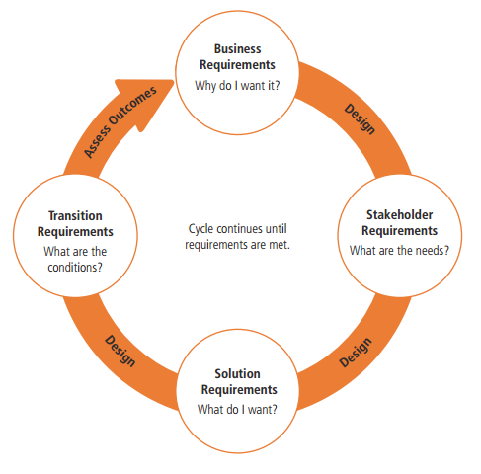
Requirements and Designs

Slide 5
Thank you!

