Slide 1
CHAPTER 2: Business Analysis Key Concepts
2.1.Business Analysis Core Concept Model
2.2.Key terms
2.3.Requirements Classification Schema
2.4.Stakeholders
2.5.Requirement & Designs

Slide 2
2.1 BUSINESS ANALYSIS CORE CONCEPT MODEL
Study group: Hien and Ngoc
Date: 3 May 2017

Slide 3
What is BACCM?
Conceptual framework for business analysis: What is BA and what it means to those performing BA.
Consists of 6 concepts: Change, Need, Value, Solution, Stakeholder, Context,
All 6 are used for all perspectives, industries, methodologies, levels in organization
6 concepts of equal importance and each concept play roles to help fully understand another concepts

Slide 4
What is BACCM used for?
Describing the profession and domain of the BA
Communicating BA with common terminology
Evaluating the relationship of the key concepts in BA
Performing better BA by evaluating relationship among the 6 concepts
Evaluating the impacts of 6 concepts and their relationship at any point during a work effort to lay a foundation and a path forward

Slide 5
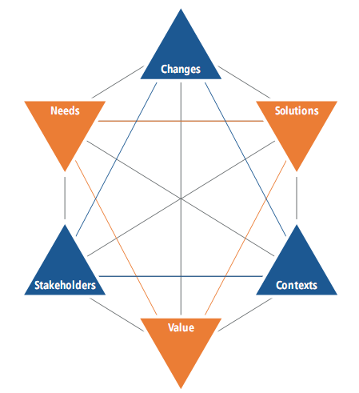
6 Core concepts
Change: transformation in response to a need
Need: Problem or opportunity to be addressed
Solution: way to satisfy a need
Stakeholder: 1 or groups in relationship to the change, need or solution
Value: worth/importance/usefulness of something to a stakeholder in a certain context
Context: circumstance to form the setting of a change and provide understanding and assessment of the change

