Slide 1


DEALER PROGRAM
Learning Management System

Slide 2



ABOUT SMART TRAINER
DEALER PROGRAM
We are seeking a Dealer Channel who are serious about expanding their portfolio in the Training and Development Industry Medical, relating to Government, Corporate, Education, and small to medium enterprises.
Your customer base will be very keen to expand in Health and Safety, Compliance, Generic, and affordable training previously not accessible together with accurate record keeping.

Slide 3

H O W D O
W E W O R K ?
STRATEGY
IDEALLY OUR PARTNERS WILL BE ACTIVELY INVOLVED IN HANDS-ON TRAINING OF CORPORATE BUSINESSES AND WILL HAVE STRONG RELATIONSHIPS WITH THEIR EXISTING CUSTOMERS.
THEY WILL SEE SMART TRAINER AS A TOTAL SOLUTION TO CONNECTED TO HANDS ON TRAINING TO SUIT MODERN TRAINING NEEDS OF STAFF ALONG WITH WHAT TRADITIONAL TRAINING YOU ARE CURRENTLY DOING NOW

Slide 4

INDUSTRIES WE COVER

Slide 5





COMMISSION STRUCTURE
B R O N Z E
S I L V E R
$ 2 5 , 0 0 1 - $ 7 5 , 0 0 0
G O L D
$ 7 5 , 0 0 1 - $ 1 5 0 , 0 0 0
P L A T I N U M
0 - $ 2 5 , 0 0 0
$ 1 5 0 , 0 0 1 - U N L I M I T E D

Slide 6
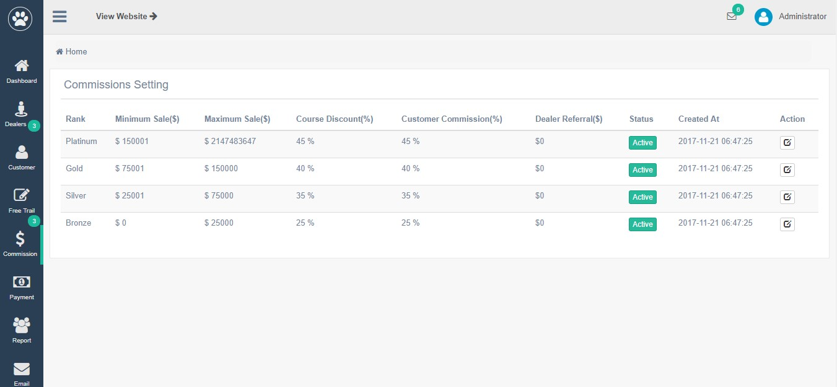
COMMISSION SETTING

Slide 7
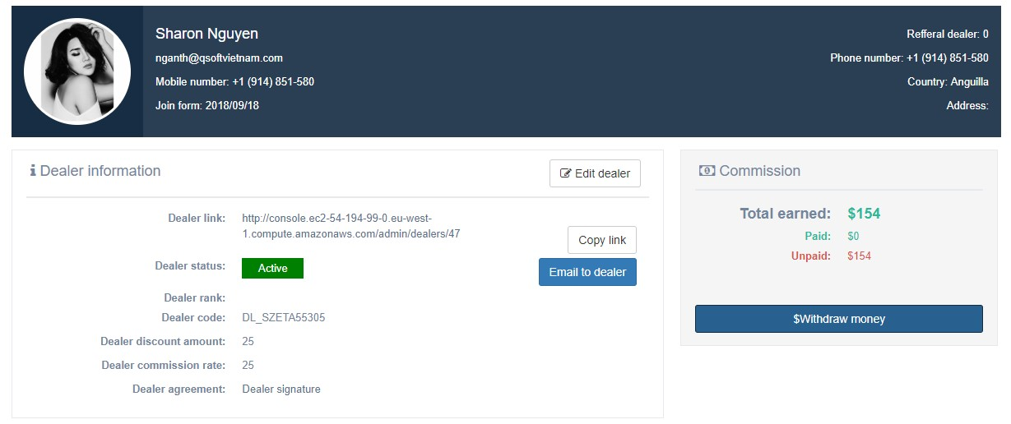
DEALER DETAIL

Slide 8
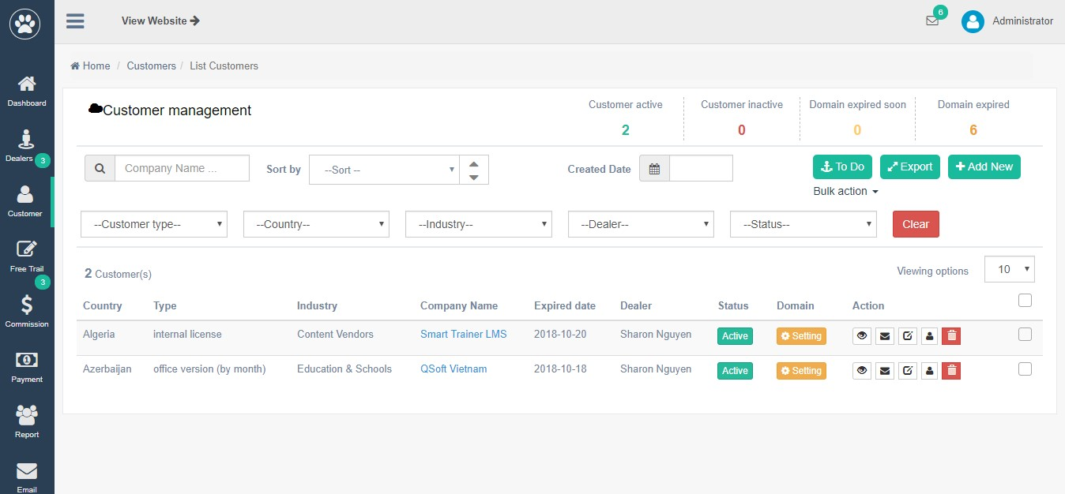
MANAGE CUSTOMERS

Slide 9
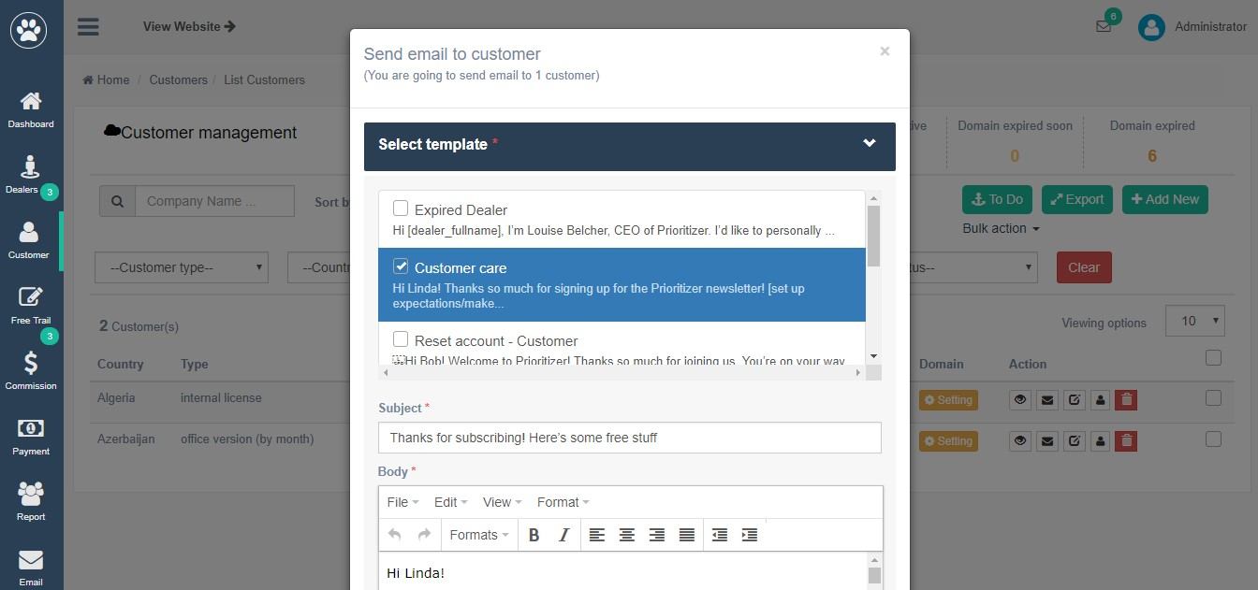
SELECT EMAIL TO SENT TO CUSTOMER

Slide 10
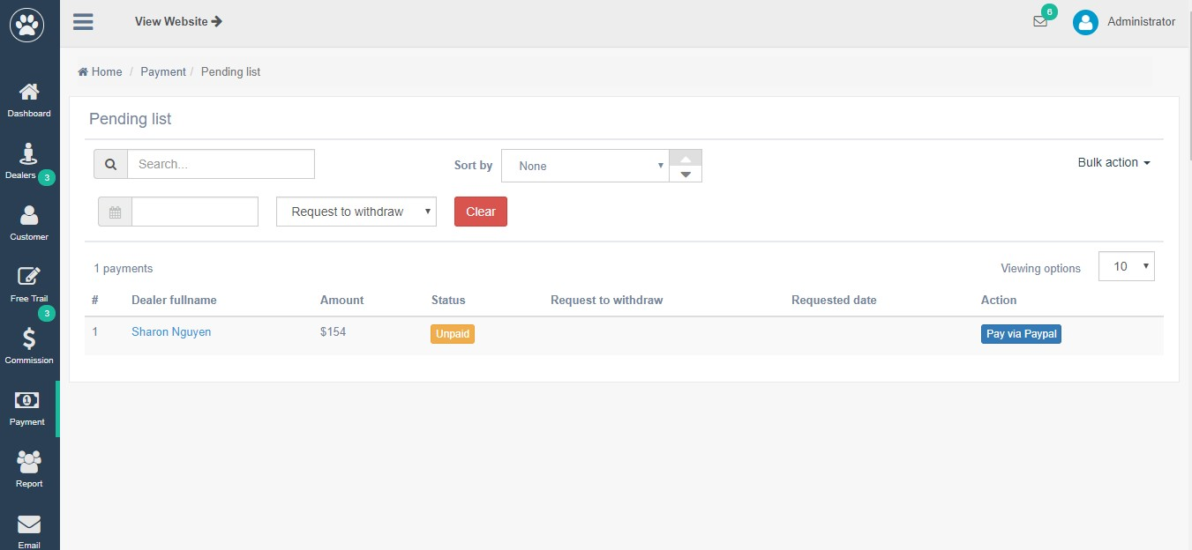
PENDING PAYMENT - FOR ADMIN TO HANDLE PAYMENT

Slide 11
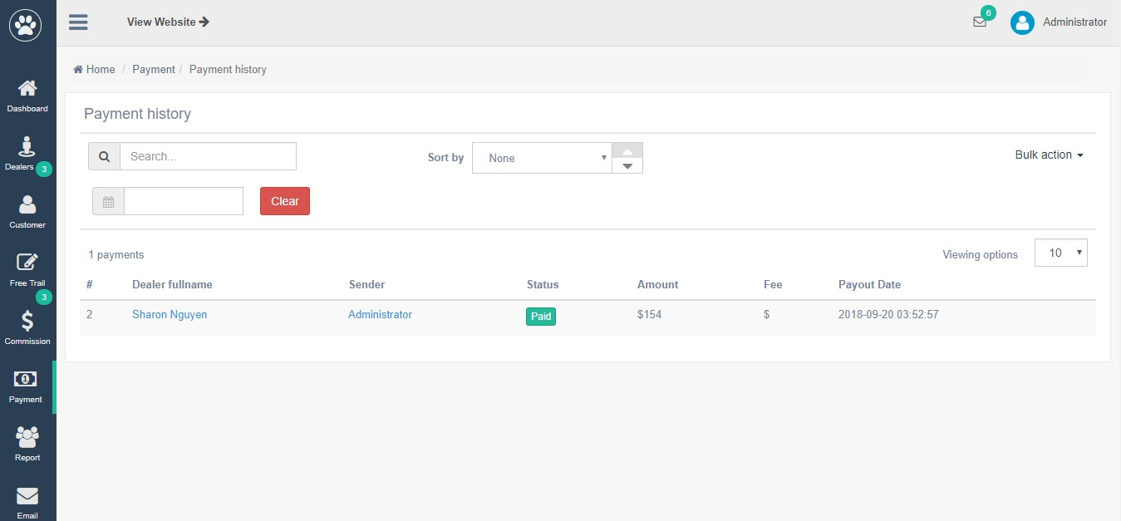
PAYMENT HISTORY

Slide 12



OUR ESTEEMED DEALERS...

Slide 13


Thanks for attending & Become our dealer!

Slide 14

QUESTIONS?

