Slide 1
Metadata - Data Binding
HANOI – AUG, 2016

Slide 2
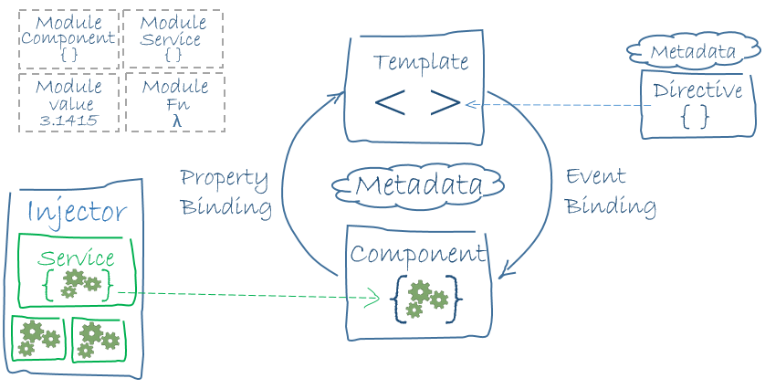
Metadata
Metadata tells Angular how to process a class.

Slide 3
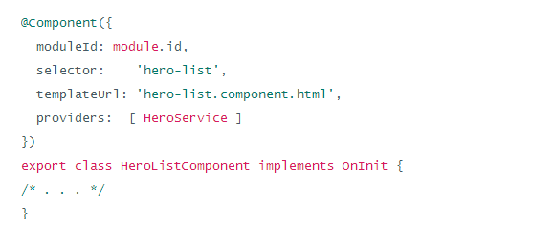
Example
Here's some metadata for HeroListComponent
Notes:
The above code includes the following configuration options:
You can configure the index.html file using typescript version. The SystemJS transpile the TypeScript to JavaScript before running the application by using the transpiler option.
If you do not transpile to JavaScript before running the application, you could see the compiler warnings and errors which are hidden in the browser.
The TypeScript generates metadata for each and every class of the code when the emitDecoratorMetadata option is set. If you don't specify this option, large amount of unused metadata will be generated which affects the file size and impact on the application runtime.
Angular 2 includes the packages form the app folder where files will have the .ts extension.
Next it will load the main component file from the app folder. If there is no main component file found, then it will display the error in the console.
When Angular calls the bootstrap function in main.ts, it reads the Component metadata, finds the 'app' selector, locates an element tag named app, and loads the application between those tags.

Slide 4
Defining the MetaData
Here is the @Component decorator, which identifies the class immediately below it as a component class.
ModuleId
Selector:
TemplateUrl
Directives
Providers

Slide 5
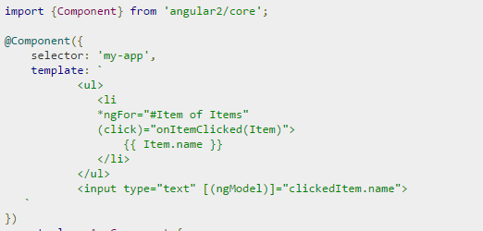
Importing What We Need
Import keyword
Angular library
Module name
Member name

Slide 6
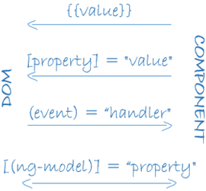
Data Binding
As the diagram shows, there are four forms of data binding syntax. Each form has a direction — to the DOM, from the DOM, or in both directions.

Slide 7
Example
The HeroListComponent example template has three forms:
The {{hero.name}} interpolation displays the component's hero.name property value within the <li> tags.
The [hero] property binding passes the value of selectedHero from the parent HeroListComponent to the hero property of the childHeroDetailComponent.
The (click) event binding calls the component's selectHero method when the user clicks a hero's name.

Slide 8
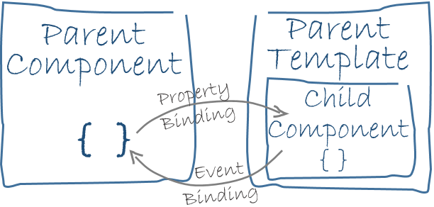
Two-way data binding
Two-way data binding is an important fourth form that combines property and event binding in a single notation, using the ngModel directive
Data binding plays an important role in communication between a template and its component.
Data binding is also important for communication between parent and child components.

