Slide 1
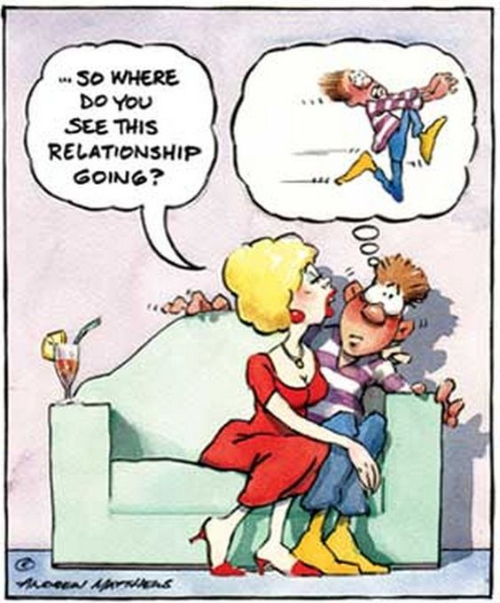
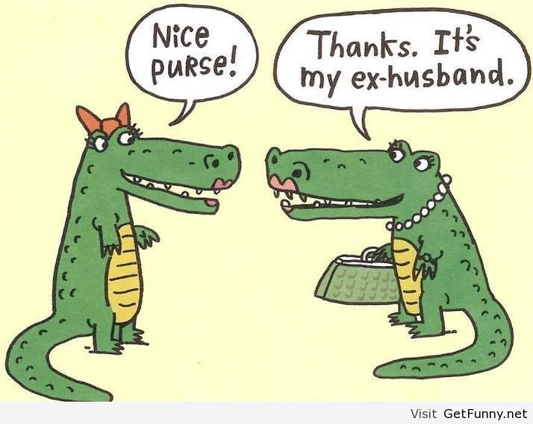
Relationship
Lecturer: Duc Le - IZONE

Slide 2
Verbs
LOVE RAT (n)
somebody who cheats on his/her partner
Don’t even think about asking Jane out. How could you look your wife in the eye? Don’t be a love rat.
THOSE THREE LITTLE WORDS
I love you (yes, that’s exactly three words)
I think he loves me, but he hasn’t said those three little words yet.

Slide 3
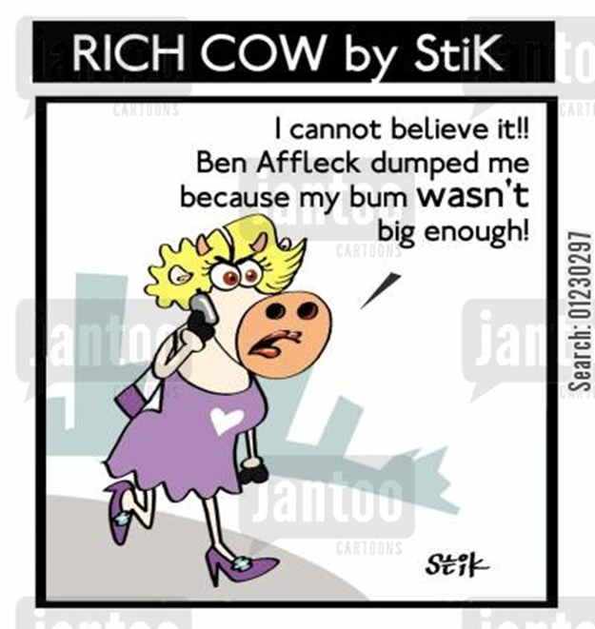
He/ she dumped me:
Blind date: a romantic social meeting between two people who have never met each other:

Slide 4
Heart rule your head:
To be Smitten with /by somebody/something (adj)
He was so smitten by her that he promised to move to Argentina to be near her.

Slide 5
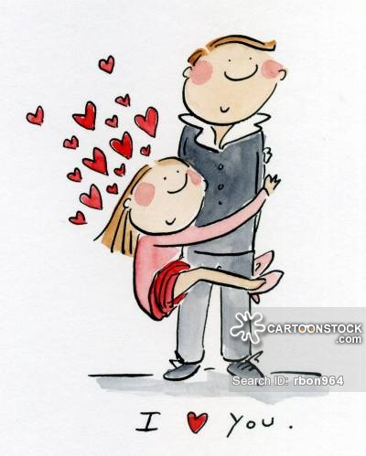
Verbs
Fall for some body: to be strongly attracted to somebody; to fall in love with somebody

Slide 6
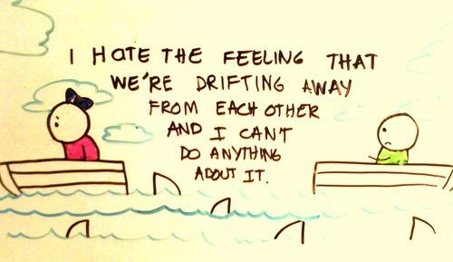
Verbs
To Drift apart: to become less close to someone
to have ups and downs: to have good and bad times

Slide 7
Iron out: ease a problem
It's only a little problem. I can iron it out very quickly.
A match made in heaven – two people who are extremely compatible and will have a great life together
Ex: We are a match made in heaven. Let’s get married.

Slide 8
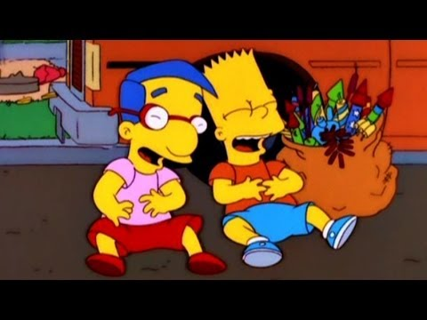
Verbs
to enjoy someone’s company: to like spending time with someone
Know someone inside out : know very well
To have a lot in common: share the same interest

Slide 9
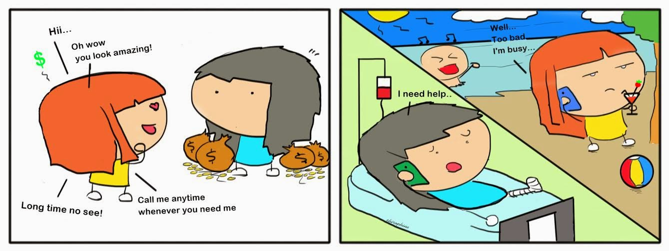
Idioms
A fair-weather friend: A person who is dependable in good times but is not in times of trouble.
Ex: You can't rely on Hieu. He is strictly a fair-weather friend.

Slide 10
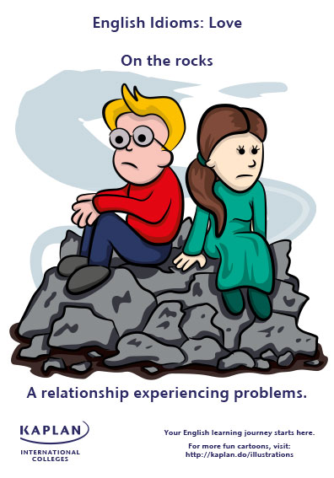
Idioms
To be on the rocks: if something such as a marriage or a business is on the rocks, it is experiencing very severe difficulties and looks likely to end very soon
She admitted that her marriage was
on the rocks.
Our film industry is on the rocks

Slide 11
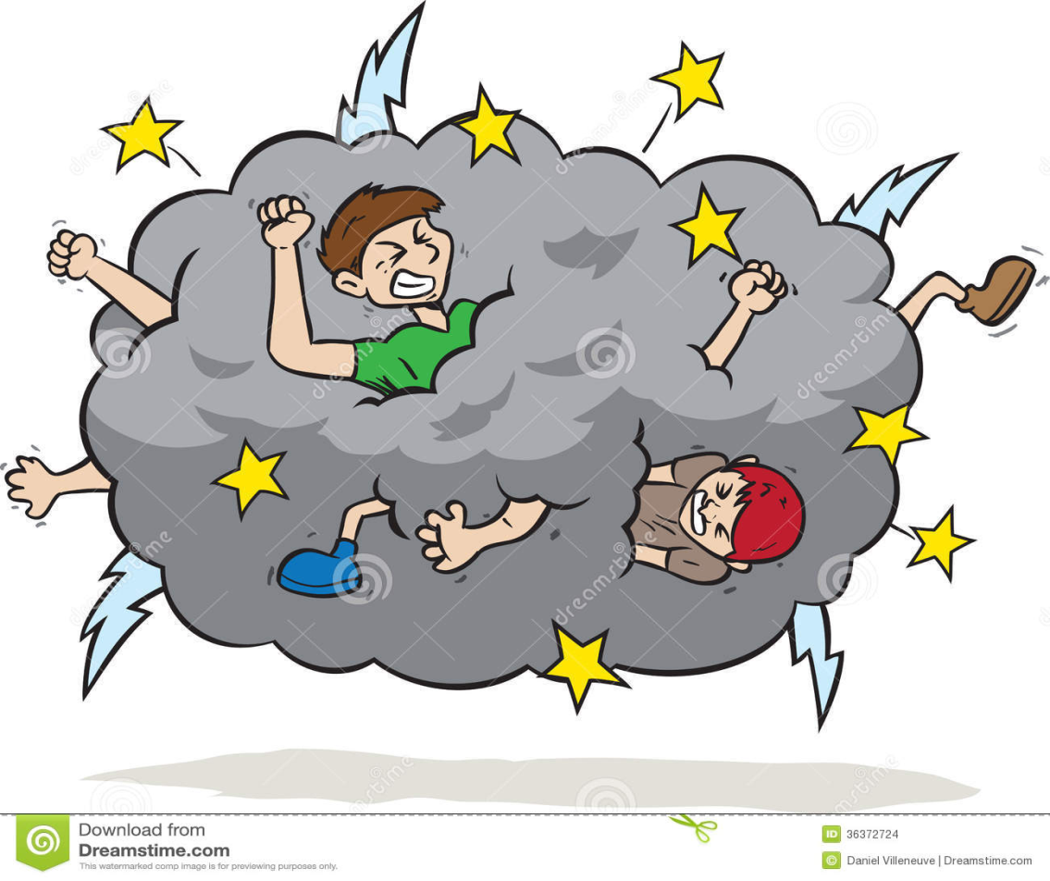
sworn enemies(noun phrase) = really hate someone:
Ex: Those two are sworn enemies.
=> Kẻ thù không đội trời chung

Slide 12
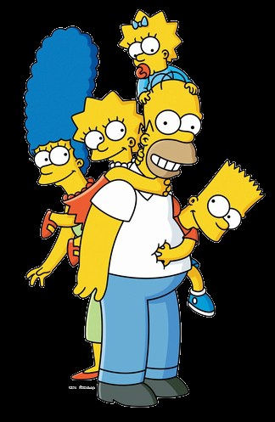
Family relationship
A close knit family: a family get on well, support each other & see each other a lot
Example: Family is the most important thing in the whole world and we ought to prioritize to make it a happy and a close knit family.

Slide 13
Family relationship
Flesh and blood: people who are part of your immediate family
Example: While she is not my flesh and blood, she is really like my sister

Slide 14
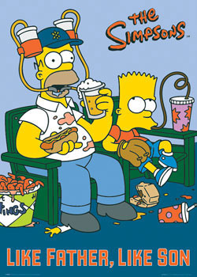
Family Relationship
Look up to (thần tượng or kính trọng ai đó)
Vd: When I was a child I always look up to my uncle. He was a real hero in my life.
Like father like son: A son's character or
behavior can be expected to resemble
that of his father.
Ex:
Jill: George's father smoked all the time,
and now George is smoking excessively, too
Jane: Like father, like son, eh

Slide 15
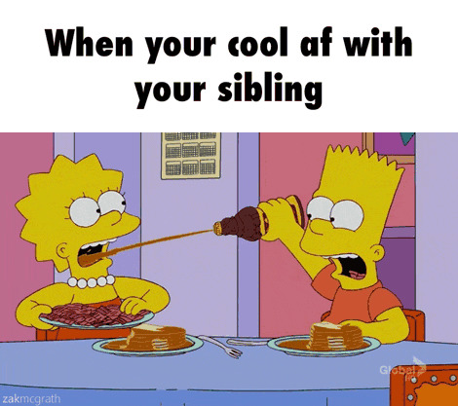
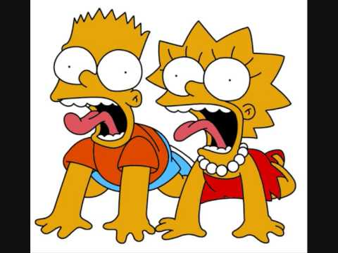
Family relationship
Sibling /ˈsɪblɪŋ/ (n): brother or sister
Ex: The younger children were badly treated by older siblings
Two peas in pod (noun phrase):
ngoại hình giống nhau như hai
giọt nước hoặc có ý kiến, quan điểm
giống nhau về một vấn đề nào đó
Ex: We’re like two peas in a pod –
our tastes are exactly the same

